Slide 1


Functional programming in concurrent and distributed systems
381-1-0112 | SM B 2018| Tutorial 5
David Leon

Slide 2
Outline
Concurrency vs. Parallelism
Concepts of Concurrency
Scaling of Problems
Concurrency in Practice
Creating processes
Sending messages
Receiving messages
Example
Submission procedures

Slide 3
#1 Concurrency vs. Parallelism
Concurrency
Many actors running independently
Not necessarily all at the same time
Concurrency contain the parallelism.
Parallelism
Actors running exactly at the same time.
The same program is shared between actors.

Slide 4
Parallelism
Threads brought with them many issues of parallel programming such as sharing resources. Typically, this is done by semaphores which simply lock a token. In case the programmer doesn’t take in count that there are shared resources you may end with program that works only by chance.
The alternative to threads is, processes.
Code and data are maintained by the OS.
Processes by default operate in an independent memory area.
Usually, process is unable to affect data of other processes.

Slide 5

Parallelism
Threading model sits well with OpenMP while the process model with MPI (MPICH library for example).
In terms of GPUs – combining both approaches. CUDA (Compute Unified Device Architecture, by nvidia) or OpenCL uses a grid of blocks of threads.
This can be thought of as a queue (grid) of processes (block) with no inter-porcess communication. Within each block there are many threads which operate cooperatively in groups called warps.
Unlike concurrency the parallelism model treat processes/threads that run at the same time.

Slide 6
#2 Concepts of Concurrency
Scalability
Processes are started and destroyed very quickly
Switching contexts of processes is fast
Possible due to lightweight processes
Fault-tolerance
Supervisors
Hardware failures
Communication
Message Passing
Implementation
Erlang is a VM-based language
OS is not trusted to handle processes in manner of optimization and reliability

Slide 7
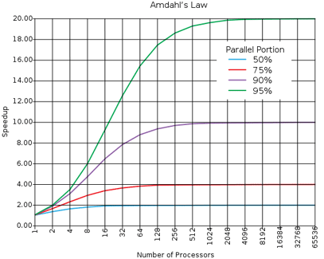
#3 Scaling of Problems
Most of the problems cannot be scaled very well
Examples of problems that scale well: ray-tracing, brute-force searches in cryptography, weather prediction, etc.
Your parallel program only goes as fast as its slowest sequential part
Follow Amdahl's law →
100% parallel, is it practical?

Slide 8
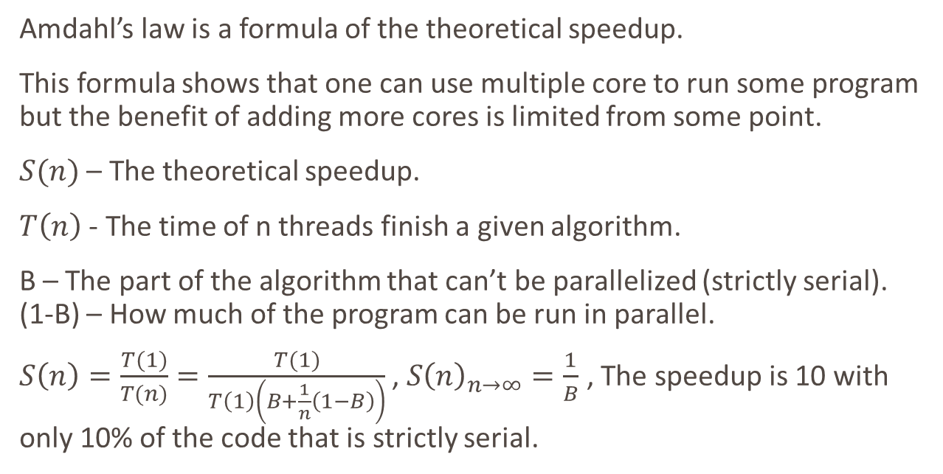
Amdahl’s Law
Amdahl’s law is a formula of the theoretical speedup.
This formula shows that one can use multiple core to run some program but the benefit of adding more cores is limited from some point.
$S(n)$ – The theoretical speedup.
$T\left(n\right)$ - The time of n threads finish a given algorithm.
B – The part of the algorithm that can’t be parallelized (strictly serial). (1-B) – How much of the program can be run in parallel.
$S\left(n\right)=\frac{T(1)}{T(n)}=\frac{T(1)}{T\left(1\right)\left(B+\frac{1}{n}\left(1−B\right)\right)}$ , $S{\left(n\right)}_{n→∞}=\frac{1}{B}$ , The speedup is 10 with only 10% of the code that is strictly serial.

Slide 9
Amdahl's Law Limitations
Not every action done in a program will have the same amount of parallelization.
Amdahl's Law only applies if the CPU is the bottleneck.
Many programs are hard-coded to use a certain number of cores.
Estimating the performance of a CPU will only be accurate for CPUs based similar architecture.

Slide 10
#4 Concurrency in Practice
The three primitives required for concurrency in Erlang
Spawning new processes
Sending messages
Receiving messages

Slide 11
#4.1 Creating Processes
We create a new process by calling function spawn/1, where the argument is a function that contains the code for the created process
What the output of the second command means?
A Process Identifier (PID)
It is used as an address to communicate with the process
One can use the BIF self/0 to obtain the PID of the current process

Slide 12
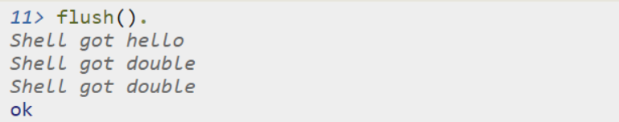
#4.2 Sending Messages
A process can send messages (message passing) using the operator !
To see the contents of the current mailbox, you can use the BIF flush()

Slide 13
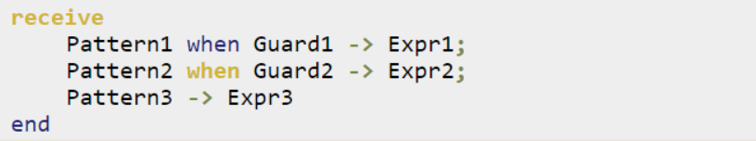
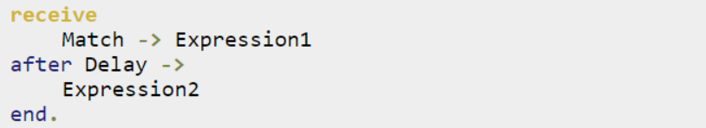
#4.3 Receiving Messages
We can read incoming messages using the receive statement
When using after, Expression2 will be triggered if as much time as Delay has been spent without receiving a message that matches the Match pattern (in ms)

Slide 14
#4.3 Receiving Messages
Each process holds queue of messages.
Inside the “receive block”: only messages that have a match with pattern will be pulled out from the queue, the rest won’t be wiped out.
Clean the queue by using flush() command or implementing receive block that matches any pattern (using “_” in order to capture any pattern).
The following case may result in queue overflow: Sender code: RxPID ! {time,1200} Receiver code: rx_loop()-> receive {A,B} when erlang:is_atom(B) -> not_ok end.

Slide 15
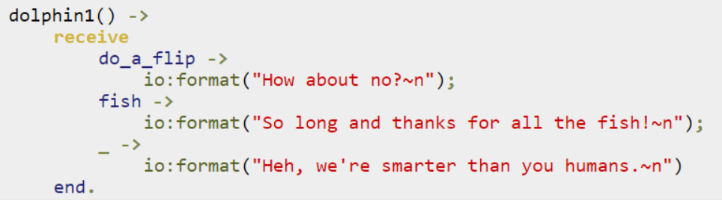
#4.3 Receiving Messages
Example 1

Slide 16
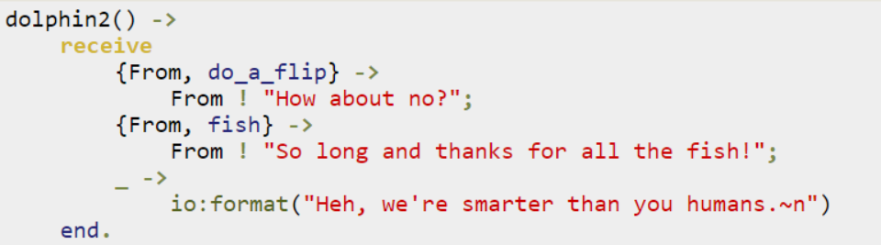
#4.3 Receiving Messages
Example 2

Slide 17
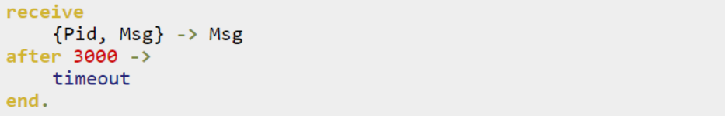
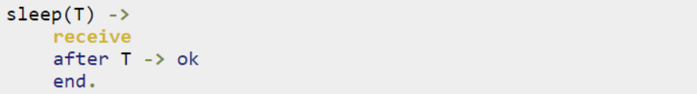
#4.3 Receiving Messages
Example 3.1
Example 3.2

Slide 18
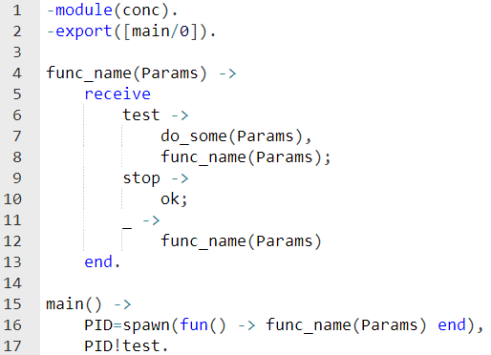
#5 Example
Example

Slide 19
Submission Procedures EX-5
A single erlang file should be submitted: ex5_<ID>.erl
A single report file should be submitted: ex5_<ID>_report.pdf (Optional)
A single design file should be submitted: ex5_<ID>_design.pdf
Files should be submitted on moodle separately. No zip! (-10 points if extra work is needed)
Before you implement the required tasks you should write a design document that describes exactly the structures that are being used and a scheme of you work.
Your code MUST be well documented
Functions’ names must be identical to the ones defined in exercise
Same as for the arity
Same as for the output format
Only the tested functions needs to be exported
Internal functions MUST NOT be exported
Assignments will be tested automatically on an Erlang shell version 21, Ubuntu 18.04.
No excuses

Slide 20
Submission Procedures
Exercise 5 should be presented on class by student.

Slide 21
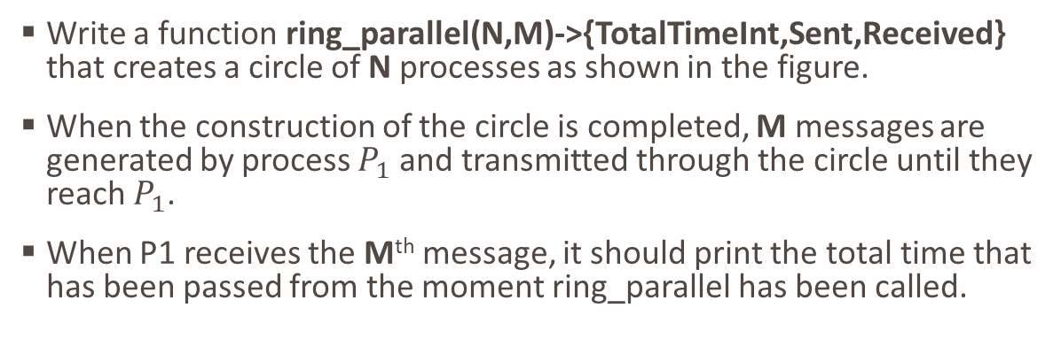
Exercise 5
Write a function ring_parallel(N,M)->{TotalTimeInt,Sent,Received} that creates a circle of N processes as shown in the figure.
When the construction of the circle is completed, M messages are generated by process $P_{1}$ and transmitted through the circle until they reach $P_{1}$.
When P1 receives the Mth message, it should print the total time that has been passed from the moment ring_parallel has been called.
$$P_{1}$$
𝑃_1
$$P_{N−2}$$
𝑃_(𝑁−2)
$$P_{N}$$
𝑃_𝑁
$$P_{2}$$
𝑃_2
$$P_{3}$$
𝑃_3
$$P_{4}$$
𝑃_4
$$P_{N−1}$$
𝑃_(𝑁−1)

Slide 22
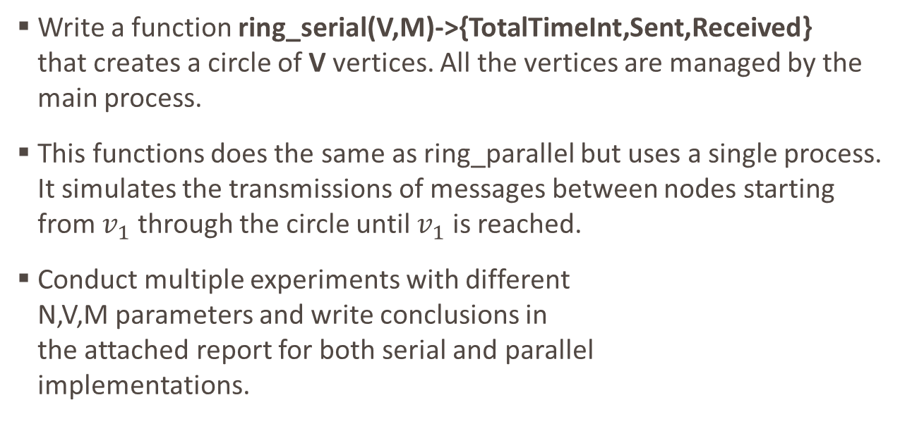
Exercise 5
Write a function ring_serial(V,M)->{TotalTimeInt,Sent,Received} that creates a circle of V vertices. All the vertices are managed by the main process.
This functions does the same as ring_parallel but uses a single process. It simulates the transmissions of messages between nodes starting from $v_{1}$ through the circle until $v_{1}$ is reached.
Conduct multiple experiments with different N,V,M parameters and write conclusions in the attached report for both serial and parallel implementations.
$$v_{1}$$
𝑣_1
$$v_{N−2}$$
𝑣_(𝑁−2)
$$v_{N}$$
𝑣_𝑁
$$v_{2}$$
𝑣_2
$$v_{3}$$
𝑣_3
$$v_{4}$$
𝑣_4
$$v_{N−1}$$
𝑣_(𝑁−1)

Slide 23
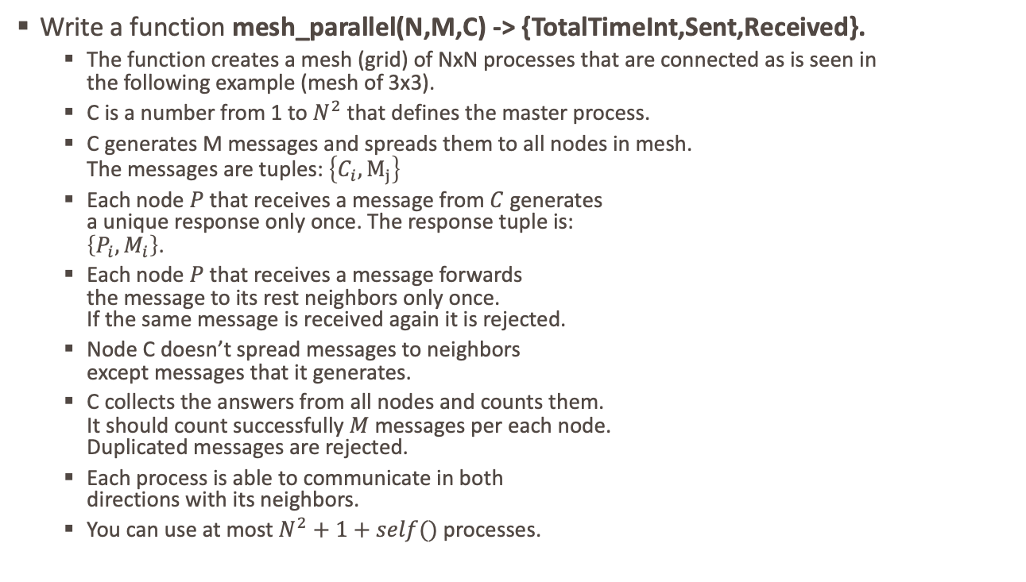
Exercise 5
Write a function mesh_parallel(N,M,C) -> {TotalTimeInt,Sent,Received}.
The function creates a mesh (grid) of NxN processes that are connected as is seen in the following example (mesh of 3x3).
C is a number from 1 to $N^{2}$ that defines the master process.
C generates M messages and spreads them to all nodes in mesh. The messages are tuples: $\left\{C_{i}, M_{j}\right\}$
Each node $P$ that receives a message from $C$ generates a unique response only once. The response tuple is: $\left\{P_{i},M_{i}\right\}$.
Each node $P$ that receives a message forwards the message to its rest neighbors only once. If the same message is received again it is rejected.
Node C doesn’t spread messages to neighbors except messages that it generates.
C collects the answers from all nodes and counts them. It should count successfully $M$ messages per each node. Duplicated messages are rejected.
Each process is able to communicate in both directions with its neighbors.
You can use at most $N^{2}+1+self()$ processes.
P1
P2
P3
P4
P5
P6
P7
P8
P9

Slide 24
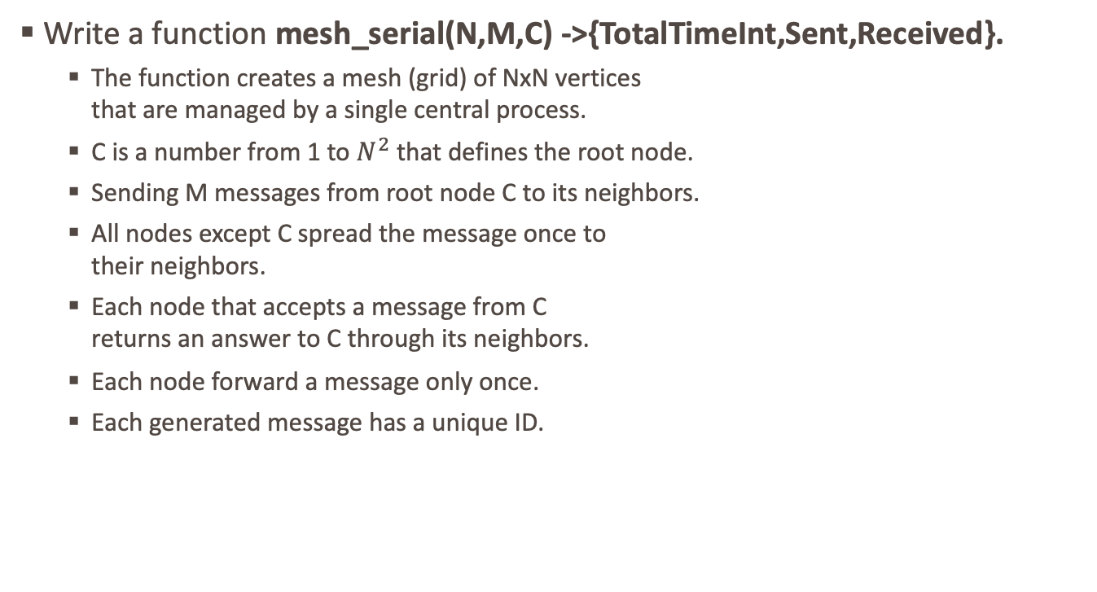
Exercise 5
Write a function mesh_serial(N,M,C) ->{TotalTimeInt,Sent,Received}.
The function creates a mesh (grid) of NxN vertices that are managed by a single central process.
C is a number from 1 to $N^{2}$ that defines the root node.
Sending M messages from root node C to its neighbors.
All nodes except C spread the message once to their neighbors.
Each node that accepts a message from C returns an answer to C through its neighbors.
Each node forward a message only once.
Each generated message has a unique ID.
P1
P1
P1
P1
P1
P1
P1
P1
P1

Slide 25
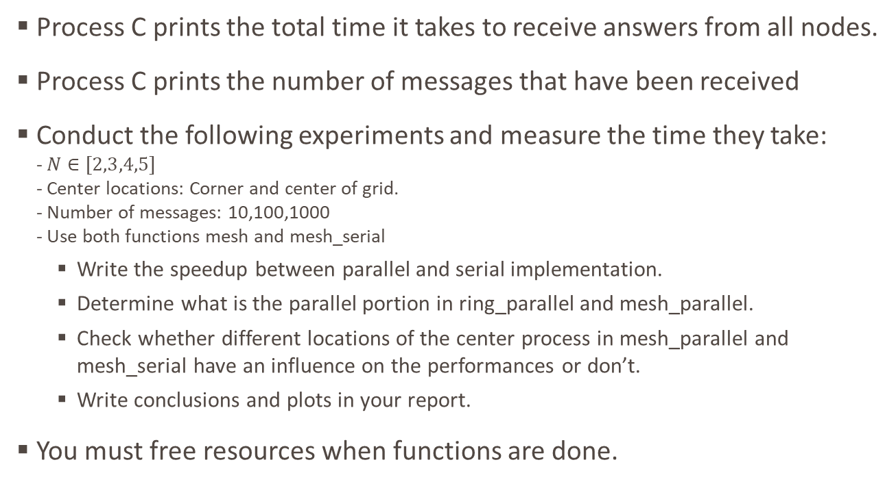
Exercise 5
Process C prints the total time it takes to receive answers from all nodes.
Process C prints the number of messages that have been received
Conduct the following experiments and measure the time they take: - $N∈[2,3,4,5]$ - Center locations: Corner and center of grid. - Number of messages: 10,100,1000 - Use both functions mesh and mesh_serial
Write the speedup between parallel and serial implementation.
Determine what is the parallel portion in ring_parallel and mesh_parallel.
Check whether different locations of the center process in mesh_parallel and mesh_serial have an influence on the performances or don’t.
Write conclusions and plots in your report.
You must free resources when functions are done.

